Slide 1
Mars Target Encyclopedia
Kiri L. Wagstaff with Ellen Riloff, Nina L. Lanza, Chris A. Mattmann, and Paul M. Ramirez
MLIA Group Meeting
February 4, 2016

Slide 2
Collect data
Uplink commands
Downlink data
Notes:
Need for an MTE

Slide 3

Opportunity Data Archive
MER: 4M Pancam, 1.7M Navcam, 230K MI
4200+ per-sol summaries of data collected
What have we learned about these targets?
“round-trip” tracking of data products and targets
…

Slide 4
Vision: A Mars Target Encyclopedia

Slide 5
Searchable interface

Slide 6
From text to knowledge
Manual composition annotations

Slide 7
From text to knowledge
Manual composition annotations

Slide 8
From text to knowledge
Manual composition annotations

Slide 9
The corpus
LPSC 2015 abstracts (n=1987)
Parsed PDFs using Apache Tika (Mattmann)
# words parsed per document: 142 to 2433
Target list from ChemCam (n=656)

Slide 10
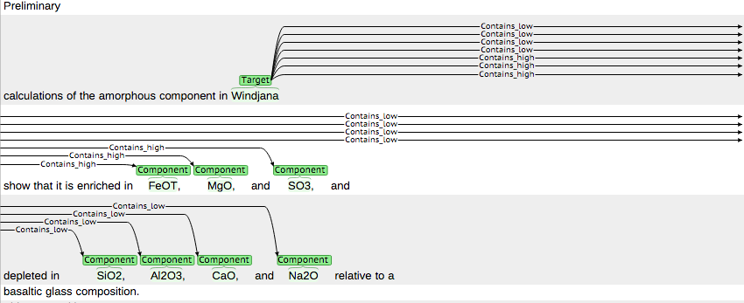
Manual composition annotations
brat: interactive annotation and visualization
Python script to import to PostgreSQL DB

Slide 11
Initial results
LPSC 2015
1438
Dillinger
Dillinger contains low Na/K ratio (doc 1438)
Dillinger contains illite clays (doc 1438)
Dillinger contains K-feldspar (doc 1438)
Dillinger contains high K (doc 1438)
Dillinger contains fluorine (doc 1989)
Dillinger contains pyroxene (doc 2038)
Dillinger contains K-feldspar (doc 2038)
Dillinger contains magnetite (doc 2038)
Dillinger contains phyllosilicate (doc 2038)
1989
Mars Target Database (MTDB)
2038
2620
2893
Notes:
Target composition and fact provenance

Slide 12
Initial results
LPSC 2015
1438
Dillinger
Dillinger contains low Na/K ratio (doc 1438)
Dillinger contains illite clays (doc 1438)
Dillinger contains K-feldspar (doc 1438)
Dillinger contains high K (doc 1438)
Dillinger contains fluorine (doc 1989)
Dillinger contains pyroxene (doc 2038)
Dillinger contains K-feldspar (doc 2038)
Dillinger contains magnetite (doc 2038)
Dillinger contains phyllosilicate (doc 2038)
1989
Mars Target Database (MTDB)
2038
2620
2893
Notes:
Target composition and fact provenance,
primary vs. secondary references

Slide 13
Automating text to knowledge

Slide 14
Automated annotation

Slide 15
Information extraction
Tika: PDF -> text
Sundance: text -> shallow parse
Autoslog: parse + target list -> patterns
Autoslog-TS: relevant + irrelevant docs -> prune patterns to increase precision

Slide 16
Initial automated results (Windjana)
“The Windjana sandstone contains high magnetite along with 2:1 phyllosilicates [9].”
<subj>_CONTAINS_MAGNETITE
“The high abundances of K-feldspar and iron oxides in Windjana, also reflected in the APXS chemical analysis as high K and Fe (Table 2) [7], are unusual.”
ABUNDANCE_OF_<np>
OXIDES_IN_<subj>
“Windjana is remarkable in containing an abundance of potassium feldspar (and thus K in its bulk chemistry) combined with a low abundance of plagioclase (and low Na/K in its chemistry).”
<subj>_CONTAINING_ABUNDANCE
ABUNDANCE_OF_<np>

Slide 17
Initial automated results (Windjana)
Synthesized:
Windjana
Windjana contains abundance of potassium feldspar
Windjana contains high abundances of K-feldspar and iron oxides
Windjana contains high magnetite
Windjana contains illite

Slide 18
Open questions
How to combine extractions into coherent entry? (information fusion)
Multi-source IE: papers can disagree, be superseded
Detect and resolve contradictions
Handle coreference
How to handle “epistemic modifiers”
E.g. “probably”, “likely contain”, “potential presence of”

Slide 19
MTE benefits
Questions -> commands -> observations -> publications -> knowledge
Answer questions such ass:
What is already known about target X?
Is there consensus about target X’s properties?
What other targets are like X?
What targets are most unusual?

Slide 20
Next steps
PDS funded the initial work
Paper accepted for presentation at AAAI workshop on Knowledge Extraction from Text (KET)
“Creating a Mars Target Encyclopedia by Extracting Information from the Planetary Science Literature”
Not funded through PDART
Reviewer feedback: “Useful but too ambitious. Do a pilot study.”
Will present at MER Science Team meeting
PDS, MER, MSL all enthusiastic but no $$ so far
Next steps:
Pilot study
FY’17 R&TD concept paper?
Notes:
Co-I from div 32, science questions
CIF - presentation

